Slide 1
Globus Toolkit - 4

Slide 2
Overview
Grid Architecture
Globus Toolkit -4 Architecture
Components in Globus Toolkit -4

Slide 3
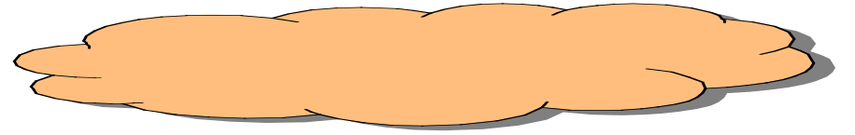

Before the Grid
User
Application
independent sites
independent hardware and software
independent user ids
security policy requiring local connection to the machine.
The User is responsible for resolving the complexities of the environment
Network
Site A
Site B

Slide 4
The Grid Today
Request info from the grid
1
Common Middleware
abstracts independent, hardware, software, user ids, into a service layer with defined APIs
comprehensive security,
allows for site autonomy
provides a common infrastructure based on middleware
User
2
Get response
Application
Make selection and submit job
2
1
3
3
Grid Middleware
Infrastructure
Network
The underlying infrastructure is abstracted into defined APIs thereby simplifying developer and the user access to resources, however, this layer is not intelligent
Site A
Site B

Slide 5
Layered Grid Architecture
(By Analogy to Internet Architecture)
Application
Application
Internet Protocol Architecture
“Coordinating multiple resources”: ubiquitous infrastructure services, app-specific distributed services
Collective
“Sharing single resources”: negotiating access, controlling use
Resource
“Talking to things”: communication (Internet protocols) & security
Connectivity
Transport
Internet
“Controlling things locally”: Access to, & control of, resources
Fabric
Link
Notes:
We define Grid architecture in terms of a layered collection of protocols.
Fabric layer includes the protocols and interfaces that provide access to the resources that are being shared, including computers, storage systems, datasets, programs, and networks. This layer is a logical view rather then a physical view. For example, the view of a cluster with a local resource manager is defined by the local resource manger, and not the cluster hardware. Likewise, the fabric provided by a storage system is defined by the file system that is available on that system, not the raw disk or tapes.
The connectivity layer defines core protocols required for Grid-specific network transactions. This layer includes the IP protocol stack (system level application protocols [e.g. DNS, RSVP, Routing], transport and internet layers), as well as core Grid security protocols for authentication and authorization.
Resource layer defines protocols to initiate and control sharing of (local) resources. Services defined at this level are gatekeeper, GRIS, along with some user oriented application protocols from the Internet protocol suite, such as file-transfer.
Collective layer defines protocols that provide system oriented capabilities that are expected to be wide scale in deployment and generic in function. This includes GIIS, bandwidth brokers, resource brokers,….
Application layer defines protocols and services that are parochial in nature, targeted towards a specific application domain or class of applications. These are are are … arrgh

Slide 6
Grid Components
Applications and Portals
…
Grid
Apps.
Scientific
Engineering
Collaboration
Prob. Solving Env.
Web enabled Apps
Development Environments and Tools
Grid
Tools
…
Web tools
Languages
Libraries
Debuggers
Monitoring
Resource Brokers
Distributed Resources Coupling Services
Grid
Middleware
…
Comm.
Sign on & Security
Information
Process
Data Access
QoS
Local Resource Managers
Operating Systems
Queuing Systems
Libraries & App Kernels
…
TCP/IP & UDP
Grid
Fabric
Networked Resources across Organisations
Clusters
Storage Systems
Data Sources
…
Scientific Instruments
Computers

Slide 7
Globus Toolkit
The Globus project provides open source software toolkit that can be used to build computational grids and grid based applications.
It allows sharing of computing power, databases, and other tools securely online across corporate, institutional and geographic boundaries without sacrificing local autonomy.

Slide 8
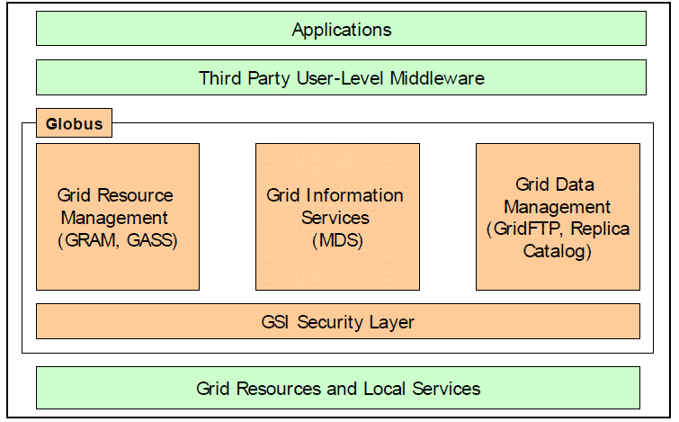
Globus Toolkit

Slide 9
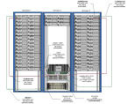
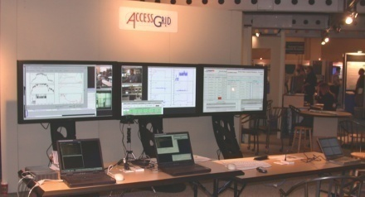
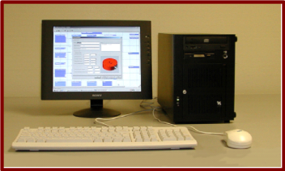
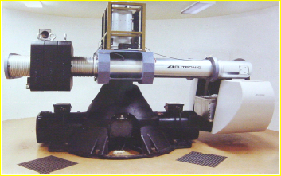
Grid Infrastructure
Application
Information Services
Execution Management
Data Management
Security
Notes:
Make points about how services have to be shared securely, moving data, starting execution on remote nodes etc.
Essentially outline requirements.

Slide 10
Globus Toolkit: Basic Grid Services
Globus Toolkit Core
  Infrastructure for building Grid services
  Uniform, standard, WS-based protocols
  Implementations in Java, C, Python, WSRF.NET
Information Services
  Discover & monitor dynamic services
Execution Management
  Provision environments, execute jobs, manage instruments
Data management
  Discover, transfer, & access large data
Security
  Authentication & Authorization
  Credential management tools

Slide 11
From Globus Toolkit version 2 (GT2)
Web Services
Components
Pre-WS
Authentication
Authorization
GridFTP
Grid Resource
Alloc. Mgmt
(GRAM)
Monitoring
& Discovery
(MDS)
C Common
Libraries
Non-WS Components
Security
Data Mgmt
Execution Mgmt
Info Services
Common
Runtime

Slide 12
To Globus Toolkit version 4 (GT4)
Core
Contrib/
Preview
Grid
Telecontrol
Protocol
Depre-
cated
Delegation
Data
Replication
Community
Scheduling
Framework
WebMDS
Python
WS Core
Community
Authorization
Data Access
& Integration
Workspace
Management
Trigger
C
WS Core
Web Services
Components
Authentication
Authorization
Reliable
File
Transfer
Grid Resource
Allocation &
Management
Index
Java
WS Core
Pre-WS
Authentication
Authorization
GridFTP
Pre-WS
Grid Resource
Alloc. & Mgmt
Pre-WS
Monitoring
& Discovery
C Common
Libraries
Non-WS Components
Credential
Mgmt
Replica
Location
eXtensible
IO (XIO)
www.globus.org
Security
Data Mgmt
Execution Mgmt
Info Services
Common
Runtime

Slide 13
Four Key Protocols
The Globus Toolkit™ centers around four key protocols
  Connectivity layer:
    Security: Grid Security Infrastructure (GSI)
  Resource layer:
    Resource Management: Grid Resource Allocation Management (GRAM)
    Information Services: Grid Resource Information Protocol (GRIP)
    Data Transfer: Grid File Transfer Protocol (GridFTP)

Slide 14
The Globus Toolkit™:
Security Services
The Globus Project™
Argonne National Laboratory
USC Information Sciences Institute
http://www.globus.org

Slide 15
GSI Security Layer
The Grid Security Infrastructure (GSI) provides methods for authentication of Grid users and secure communication.
It is based on SSL (Secure Sockets Layer), PKI (Public Key Infrastructure) and X.509 Certificate Architecture. The GSI provides services, protocols and libraries to achieve the following aims for Grid security:
  Single sign-on for using Grid services through user certificates
  Resource authentication through host certificates
  Data encryption
  Authorization
  Delegation of authority and trust through proxies and certificate chain of trust for Certificate Authorities(CAs)
Users gain access to resources by having their Grid certificate subjects mapped to an account on the remote machine by its system administrators.

Slide 16
Grid Security Infrastructure (GSI)
Extensions to standard protocols & APIs
  Standards: SSL/TLS, X.509 & CA, GSS-API
  Extensions for single sign-on and delegation
Globus Toolkit reference implementation of GSI
  SSLeay/OpenSSL + GSS-API + SSO/delegation
  Tools and services to interface to local security
    Simple ACLs; SSLK5/PKINIT for access to K5, AFS; …
  Tools for credential management
    Login, logout, etc.
    Smartcards
    MyProxy: Web portal login and delegation
    K5cert: Automatic X.509 certificate creation

Slide 17
GSI in Action
“Create Processes at A and B that Communicate & Access Files at C”
Single sign-on via “grid-id”
& generation of proxy cred.
User Proxy
User
Proxy
credential
Or: retrieval of proxy cred.
from online repository
Remote process
creation requests*
Site A
(Kerberos)
GSI-enabled
GRAM server
Authorize
Map to local id
Create process
Generate credentials
Ditto
GSI-enabled
GRAM server
Site B
(Unix)
Computer
Computer
Process
Process
Local id
Communication*
Local id
Kerberos
ticket
Restricted
proxy
Remote file
access request*
Restricted
proxy
GSI-enabled
FTP server
Site C
(Kerberos)
* With mutual authentication
Authorize
Map to local id
Access file
Storage
system

Slide 18
Review of
Public Key Cryptography
Asymmetric keys
  A private key is used to encrypt data.
  A public key can decrypt data encrypted with the private key.
An X.509 certificate includes…
  Someone’s subject name (user ID)
  Their public key
  A “signature” from a Certificate Authority (CA) that:
    Proves that the certificate came from the CA.
    Vouches for the subject name
    Vouches for the binding of the public key to the subject

Slide 19
Public Key Based Authentication
User encodes the data with private key
  Possession of private key means you can authenticate as subject in certificate
Public key is used to decode the data.
  If you can decode it, you know the subject
Treat your private key carefully!!
  Private key is stored only in well-guarded places, and only in encrypted form

Slide 20
User Proxies
Minimize exposure of user’s private key
A temporary, X.509 proxy credential for use by our computations
  We call this as user proxy certificate
  Allows process to act on behalf of user
  User-signed user proxy cert stored in local file
  Created via “grid-proxy-init” command
Proxy’s private key is not encrypted
  Rely on file system security, proxy certificate file must be readable only by the owner

Slide 21
Delegation
Remote creation of a user proxy
Results in a new private key and X.509 proxy certificate, signed by the original key
Allows remote process to act on behalf of the user
Avoids sending passwords or private keys across the network

Slide 22
GSI Applications
Globus Toolkit™ uses GSI for authentication
Many Grid tools, directly or indirectly, e.g.
  Condor-G, SRB, MPICH-G2, Cactus, GDMP, …
Commercial and open source tools, e.g.
  ssh, ftp, cvs, OpenLDAP, OpenAFS
  SecureCRT (Win32 ssh client)
And since we use standard X.509 certificates, they can also be used for
  Web access, LDAP server access, etc.

Slide 23
The Globus Toolkit™:
Resource Management Services
The Globus Project™
Argonne National Laboratory
USC Information Sciences Institute
http://www.globus.org

Slide 24
The Challenge
Enabling secure, controlled remote access to heterogeneous computational resources and management of remote computation
  Authentication and authorization
  Resource discovery & characterization
  Reservation and allocation
  Computation monitoring and control
Addressed by new protocols & services
  GRAM protocol as a basic building block
  Resource brokering & co-allocation services
  GSI for security, MDS for discovery

Slide 25
Resource Management
The Grid Resource Allocation Management (GRAM) protocol and client API allows programs to be started on remote resources, despite local heterogeneity
Resource Specification Language (RSL) is used to communicate requirements
A layered architecture allows application-specific resource brokers and co-allocators to be defined in terms of GRAM services
  Integrated with Condor, PBS, MPICH-G2, …

Slide 26
Resource Management Architecture
RSL
specialization
Broker
RSL
Application
Queries
Information Service
& Info
Ground RSL
Co-allocator
Simple ground RSL
Local
resource
managers
GRAM
GRAM
GRAM
LSF
Condor
NQE

Slide 27
Globus Toolkit Implementation
Gatekeeper
  Single point of entry
  Authenticates user, maps to local security environment, runs service
  In essence, a “secure inetd”
Job manager
  A gatekeeper service
  Layers on top of local resource management system (e.g., PBS, LSF, etc.)
  Handles remote interaction with the job

Slide 28
GRAM Components
MDS client API calls
to locate resources
Client
MDS: Grid Index Info Server
MDS client API calls
to get resource info
Site boundary
GRAM client API calls to
request resource allocation
and process creation.
MDS: Grid Resource Info Server
Query current status
of resource
GRAM client API state
change callbacks
Grid Security
Infrastructure
Local Resource Manager
Request
Allocate &
create processes
Create
Job Manager
Gatekeeper
Process
Parse
Monitor &
control
Process
RSL Library
Process

Slide 29
Job Submission Interfaces
Globus Toolkit includes several command line programs for job submission
  globus-job-run: Interactive jobs
  globus-job-submit: Batch/offline jobs
  globusrun: Flexible scripting infrastructure
Others are building better interfaces
  General purpose
    Condor-G, PBS, GRD, Hotpage, etc
  Application specific
    ECCE’, Cactus, Web portals

Slide 30
The Globus Toolkit™:
Information Services
The Globus Project™
Argonne National Laboratory
USC Information Sciences Institute
http://www.globus.org

Slide 31
Grid Information Services
System information is critical to operation of the grid and construction of applications
  What resources are available?
    Resource discovery
  What is the “state” of the grid?
    Resource selection
  How to optimize resource use
    Application configuration and adaptation?
We need a general information infrastructure to answer these questions

Slide 32
Examples of Useful Information
Characteristics of a compute resource
  IP address, software available, system administrator, networks connected to, OS version, load
Characteristics of a network
  Bandwidth and latency, protocols, logical topology
Characteristics of the Globus infrastructure
  Hosts, resource managers

Slide 33
Grid Information: Facts of Life
Information is always old
  Time of flight, changing system state
  Need to provide quality metrics
Distributed state hard to obtain
  Complexity of global snapshot
Component will fail
Scalability and overhead
Many different usage scenarios
  Heterogeneous policy, different information organizations, etc.

Slide 34
Grid Information Service
Provide access to static and dynamic information regarding system components
A basis for configuration and adaptation in heterogeneous, dynamic environments
Requirements and characteristics
  Uniform, flexible access to information
  Scalable, efficient access to dynamic data
  Access to multiple information sources
  Decentralized maintenance

Slide 35
The GIS Problem: Many Information Sources, Many Views
?
R
R
R
VO C
R
?
R
R
R
R
VO A
?
R
R
R
?
R
R
R
R
VO B
R
R

Slide 36
Information Protocols
Grid Resource Registration Protocol
  Support information/resource discovery
  Designed to support machine/network failure
Grid Resource Inquiry Protocol
  Query resource description server for information
  Query aggregate server for information
  LDAP V3.0 in Globus 1.1.3

Slide 37
GIS Architecture
Customized Aggregate Directories
Users
A
A
Enquiry
Protocol
Registration
Protocol
R
R
R
R
Standard Resource Description Services

Slide 38
Metacomputing Directory Service
Use LDAP as Inquiry
Access information in a distributed directory
  Directory represented by collection of LDAP servers
  Each server optimized for particular function
Directory can be updated by:
  Information providers and tools
  Applications (i.e., users)
  Backend tools which generate info on demand
Information dynamically available to tools and applications

Slide 39
Two Classes Of MDS Servers
Grid Resource Information Service (GRIS)
  Supplies information about a specific resource
  Configurable to support multiple information providers
  LDAP as inquiry protocol
Grid Index Information Service (GIIS)
  Supplies collection of information which was gathered from multiple GRIS servers
  Supports efficient queries against information which is spread across multiple GRIS server
  LDAP as inquiry protocol

Slide 40
Grid Resource Information Service
Server which runs on each resource
  Given the resource DNS name, you can find the GRIS server (well known port = 2135)
Provides resource specific information
  Much of this information may be dynamic
    Load, process information, storage information, etc.
    GRIS gathers this information on demand
“White pages” lookup of resource information
  Ex: How much memory does machine have?
“Yellow pages” lookup of resource options
  Ex: Which queues on machine allows large jobs?

Slide 41
Grid Index Information Service
GIIS describes a class of servers
  Gathers information from multiple GRIS servers
  Each GIIS is optimized for particular queries
    Ex1: Which Alliance machines are >16 process SGIs?
    Ex2: Which Alliance storage servers have >100Mbps bandwidth to host X?
  Akin to web search engines
Organization GIIS
  The Globus Toolkit ships with one GIIS
  Caches GRIS info with long update frequency
    Useful for queries across an organization that rely on relatively static information (Ex1 above)
Can be merged into GRIS

Slide 42
Logical MDS Deployment
Grads
Gusto
GIIS
ISI
GRISes

Slide 43
Example: Discovering CPU Load
Retrieve CPU load fields of computer resources
% grid-info-search -L “(objectclass=GlobusComputeResource)” \
dn cpuload1 cpuload5 cpuload15
dn: hn=lemon.mcs.anl.gov, ou=MCS, o=Argonne National Laboratory,
o=Globus, c=US
cpuload1: 0.48
cpuload5: 0.20
cpuload15: 0.03
dn: hn=tuva.mcs.anl.gov, ou=MCS, o=Argonne National Laboratory,
o=Globus, c=US
cpuload1: 3.11
cpuload5: 2.64
cpuload15: 2.57

Slide 44
The Globus Toolkit™:
Data Management Services
The Globus Project™
Argonne National Laboratory
USC Information Sciences Institute
http://www.globus.org

Slide 45
Data Intensive Issues Include…
Harness [potentially large numbers of] data, storage, network resources located in distinct administrative domains
Respect local and global policies governing what can be used for what
Schedule resources efficiently, again subject to local and global constraints
Achieve high performance, with respect to both speed and reliability.

Slide 46
Desired Data Grid Functionality
High-speed, reliable access to remote data
Automated discovery of “best” copy of data
Manage replication to improve performance
Co-schedule compute, storage, network
“Transparency” wrt delivered performance
Enforce access control on data
Allow representation of “global” resource allocation policies

Slide 47
A Model Architecture for Data Grids
Attribute Specification
Replica Catalog
Metadata Catalog
Application
Multiple Locations
Logical Collection and Logical File Name
Selected
Replica
MDS
Replica
Selection
Performance
Information &
Predictions
NWS
GridFTP Control Channel
GridFTP
Data
Channel
Disk Cache
Tape Library
Disk Array
Disk Cache
Replica Location 1
Replica Location 2
Replica Location 3

Slide 48
Globus Toolkit Components
Two major Data Grid components:
1. Data Transport and Access
  Common protocol
    Secure, efficient, flexible, extensible data movement
  Family of tools supporting this protocol
2. Replica Management Architecture
  Simple scheme for managing:
    multiple copies of files
    collections of files

Slide 49
And The Protocol Is … GridFTP
Why FTP?
  Ubiquity enables interoperation with many commodity tools
  Already supports many desired features, easily extended to support others
  Well understood and supported
We use the term GridFTP to refer to
  Transfer protocol which meets requirements
  Family of tools which implement the protocol
Note GridFTP > FTP
Note that despite name, GridFTP is not restricted to file transfer!

Slide 50
GridFTP: Basic Approach
FTP protocol is defined by several IETF RFCs
Start with most commonly used subset
  Standard FTP: get/put etc., 3rd-party transfer
Implement standard but often unused features
  GSS binding, extended directory listing, simple restart
Extend in various ways, while preserving interoperability with existing servers
  Striped/parallel data channels, partial file, automatic & manual TCP buffer setting, progress monitoring, extended restart

Slide 51
Replica Management
Maintain a mapping between logical names for files and collections at one or more physical locations
Important for many applications
  Example: CERN HLT data
    Multiple petabytes of data per year
    Copy of everything at CERN (Tier 0)
    Subsets at national centers (Tier 1)
    Smaller regional centers (Tier 2)
    Individual researchers will have copies

Slide 52
Replica Catalog Structure:
A Climate Modeling Example
Replica Catalog
Logical Collection
C02 measurements 1998
Logical Collection
C02 measurements 1999
Filename: Jan 1998
Filename: Feb 1998
…
Location
jupiter.isi.edu
Location
sprite.llnl.gov
Logical File Parent
Filename: Mar 1998
Filename: Jun 1998
Filename: Oct 1998
Protocol: gsiftp
UrlConstructor:
gsiftp://jupiter.isi.edu/
nfs/v6/climate
Filename: Jan 1998
…
Filename: Dec 1998
Protocol: ftp
UrlConstructor:
ftp://sprite.llnl.gov/
pub/pcmdi
Logical File Jan 1998
Logical File Feb 1998
Size: 1468762

Slide 53
Replica Catalog Services as Building Blocks: Examples
Combine with information service to build replica selection services
  E.g. “find best replica” using performance info from NWS and MDS
  Use of LDAP as common protocol for info and replica services makes this easier
Combine with application managers to build data distribution services
  E.g., build new replicas in response to frequent accesses

Slide 54
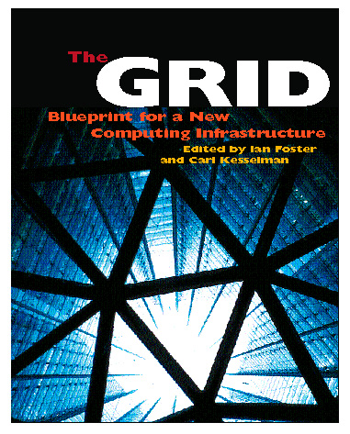
For More Information
Globus Project™
  www.globus.org
Grid Forum
  www.gridforum.org
Book (Morgan Kaufman)
  www.mkp.com/grids

